Slide 1

WEATHER AND RETAIL Purchasing Behaviour
Can weather patterns help retailers make better sales decisions?
Group 3: Saba Berenji & Sierra Erb | August 18, 2026 | PROG74030

Slide 2

TABLE OF CONTENTS
01
02
03
04
05
06
Problem Statement
Dataset
Analysis Steps
Findings
Recommendations
Limitations & Next Steps

Slide 3


Can Weather Help Retailers Make Better Decisions?
CHALLENGE
Demand can be difficult to anticipate
OPPORTUNITY
Weather forecasts are available in advance
GOAL
Identify actionable purchasing patterns
AUDIENCE
Retail managers & decision-makers

Slide 4
What Did We Analyze?
UK Online Retail Data
UK Weather Data
Retail and Weather
981K Transactions
2009-2011
Quantity - Price
Daily Weather
Temperature – Rain – Humidity –Cloud – Wind
Matched by Date
2009-2011
Note: Many customers of the retail company are wholesalers.

Slide 5

How Did We Find the Patterns?
CLUSTER
Identify patterns
EXPLORE
Find relationships
ASSOCIATE
Find related purchases
ACT
Business Insights
CLEAN
Prepare data
CLASSIFY
Predict Transactional Sales
Notes:
Handling missing and invalid values, handling duplicate rows, finding and handling outliers, and discretization

Slide 6

Three Different Purchasing Environments
 | COLD | WARM & DRY | WET, CLOUDY, & WINDY
TEMPERATURE (°C) | 4.24 | 12.05 | 10.05
RAIN (MM) | 1.15 | 0.92 | 3.95
HUMIDITY (%) | 88.74 | 81.56 | 89.11
WIND (KM/H) | 14.87 | 12.17 | 19.05
CLOUD COVER (%) | 53.71 | 42.30 | 69.09

Slide 7
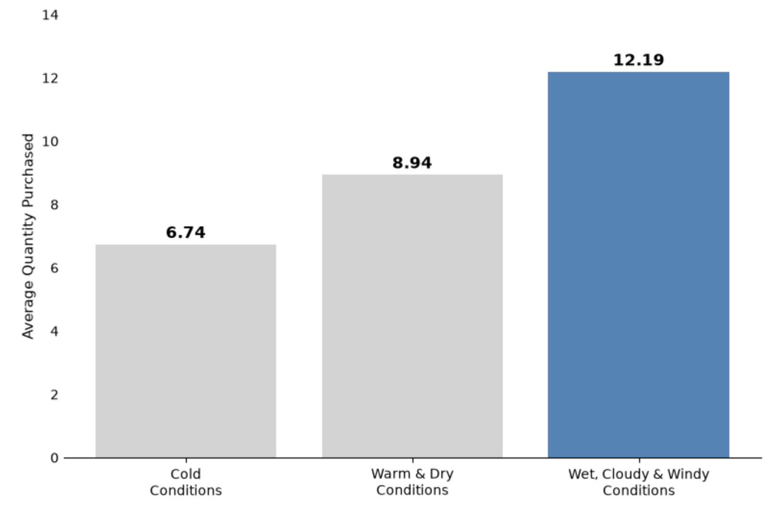
Wet, Cloudy & Windy Conditions Are Associated With Larger Purchases
12.19 Avg. Units
81% MORE
than cold conditions

Slide 8
Use Weather as an Additional Demand Signal
Forecast
Demand Signal
Review Stock
Wet, Cloudy & Windy
Historically Higher Quantity
Product Availability
RECOMMENDED ACTION
Review short-term product availability when similar weather is forecast.

Slide 9
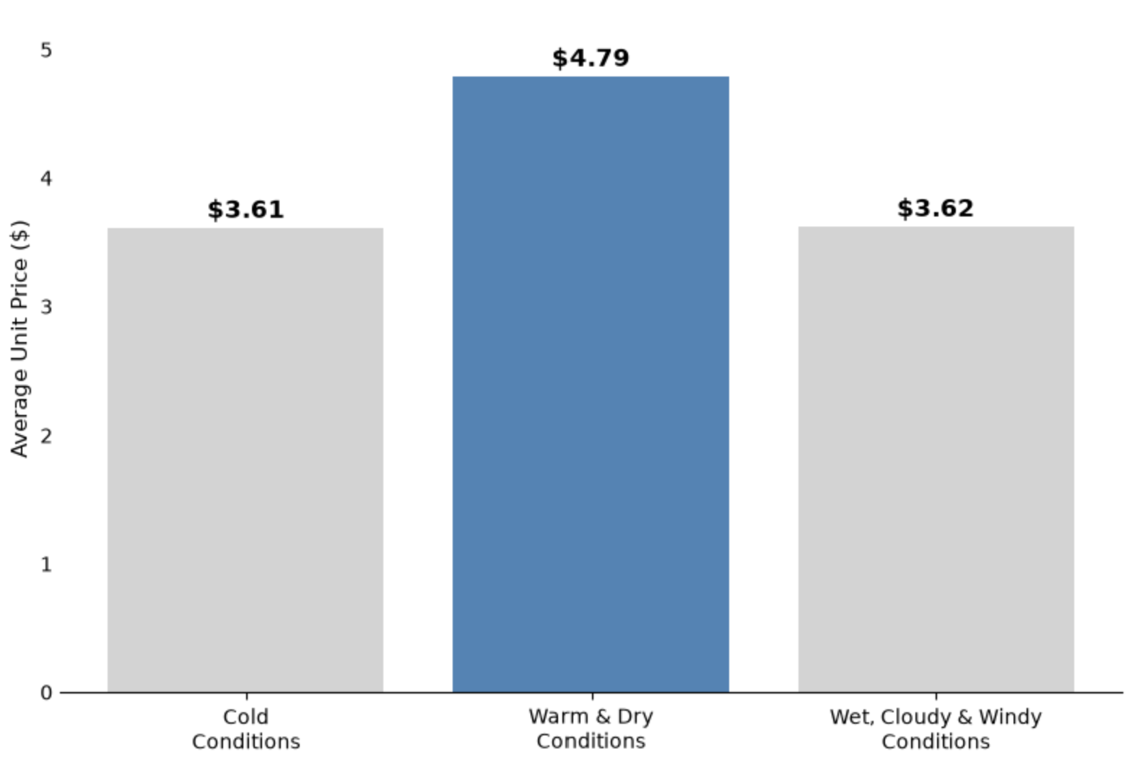
Warm & Dry Conditions Are Associated With Higher-Priced Purchases
$4.79 Avg. Unit-Price
33% MORE
than cold conditions

Slide 10
Different Weather May Require Different Sales Strategies
Forecast
Purchasing Pattern
Review Promotions
Warm & Dry Conditions
Higher-Priced Items
Purchased Historically
Promote Higher-Priced Products
RECOMMENDED ACTION
Increase the visibility or promotion of higher-priced products when similar weather is forecast.

Slide 11
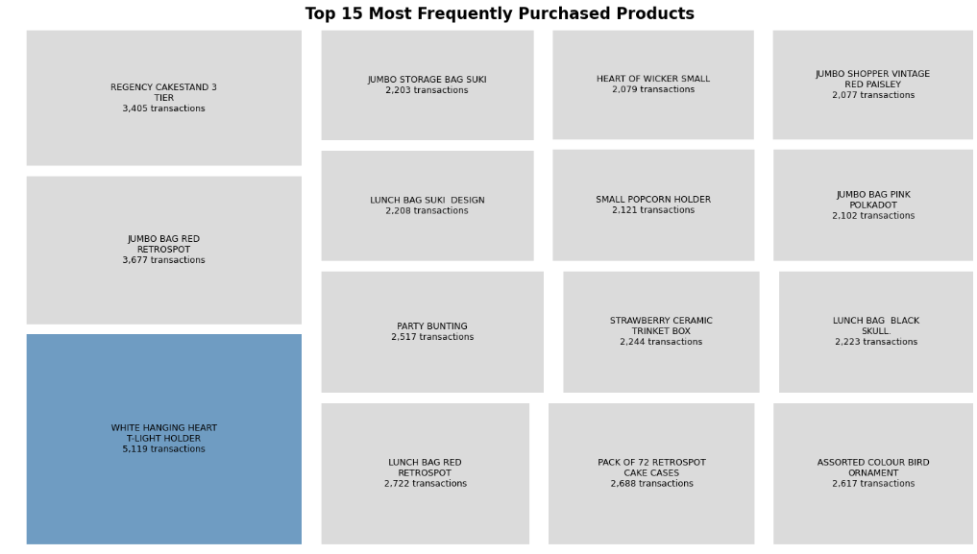
What Are Customers Buying Most Often?

Slide 12
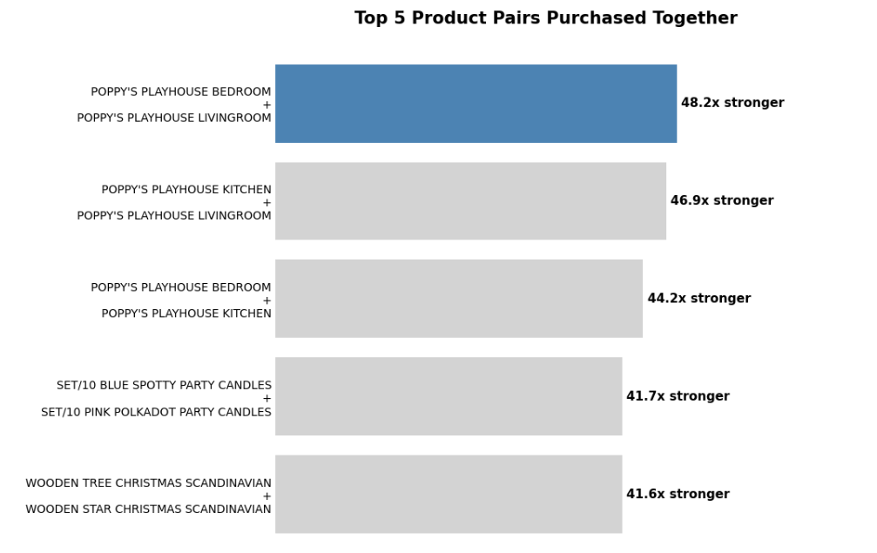
Some Product Pairs Are Strongly Associated
Poppy’s Playhouse Bedroom + Livingroom
showed the strongest product-pair relationship.
48.2×
stronger association than expected
Higher values indicate product pairs that appeared together more frequently than expected if purchases were unrelated.

Slide 13
Strong Product Pairs Can Guide Retail Decisions
Identify Strong
Product Pairs
Review How Often
They Are Purchased
Together
Bundle or
Cross-Promote
Related Products
Place Related
Products Together
RECOMMENDED ACTION
Use strong product associations to support product bundling, cross-promotion, and product placement decisions.

Slide 14
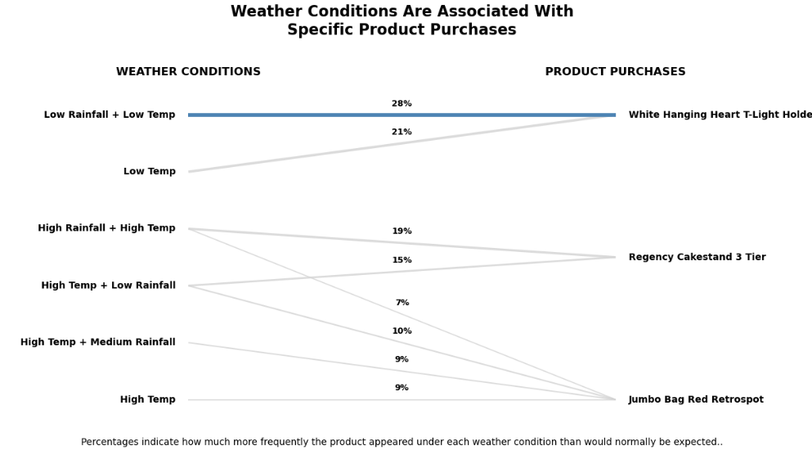
Weather Conditions Are Associated With Specific Product Purchases
Low Temperature
+ Low Rainfall
White Hanging Heart T-Light Holder
→
28% MORE EXPECTED
TO BE PURCHASED
than if weather and purchases were unrelated

Slide 15
Weather May Help Identify Changes in Product Demand
Weather Forecast
Check Historical Product Patterns
Identify Products That May See Demand Changes
Adjust Promotions / Monitor Stock
RECOMMENDED ACTION
Use weather to support demand planning, not to make stocking decisions on its own.

Slide 16
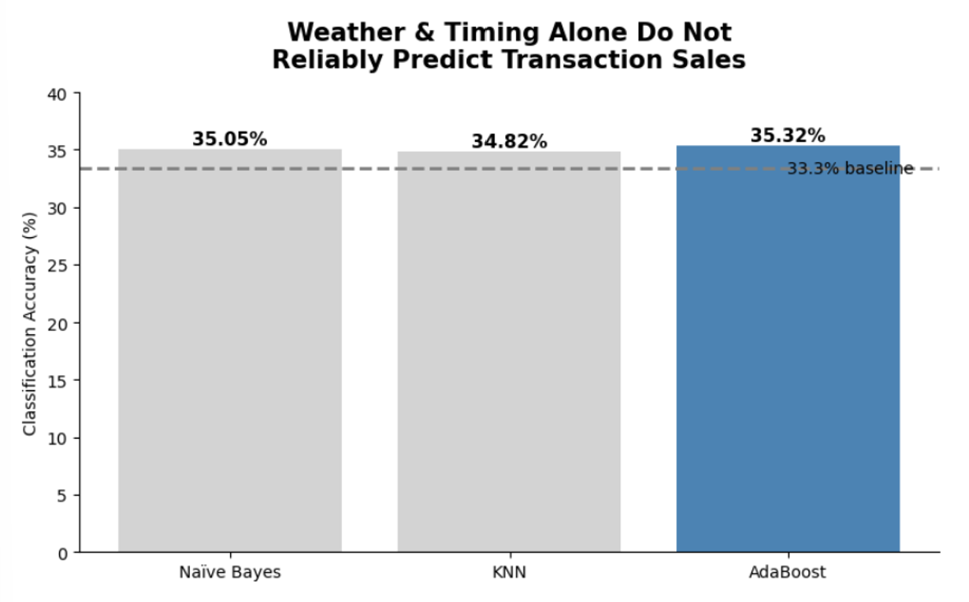
Weather & Temporal Factors Alone Do Not Reliably Predict Transaction Sales
Weather & timing correctly predicted sales categories only
~35%
of the time.

Slide 17
Weather & Timing ≠ Reliable Sales Predictor
Better Sales Decisions
Weather & Timing
Products
Prices
Promotions
Seasons & Holidays
Weather influences purchasing — but doesn’t tell the whole story.
RECOMMENDED ACTION
Use weather as supporting information, not on its own.

Slide 18
Limitations & Next Steps
Limitations
Next Steps
Associations do not prove causation
Weather relationships were relatively weak
Strategies require further testing
• Explore additional factors that may influence sales
• Combine weather with product, price, seasonal, and promotional information
• Test weather-based strategies before implementation

Slide 19
THANKS!
DO YOU HAVE ANY QUESTIONS?

